Slide 1
Crash Data Analysis
by Anasya Miftakus

Slide 2
Table of contents
01
02
03
04
Temporal Analysis
Geographic Analysis
Location, Route Type, Cross-Street Type, and Off-Road analysis
Accident trends over time, and impact of weather and surface conditions on accidents
Road Conditions and Infrastructure
Accident Characteristics
Lighting conditions analysis and impact of Traffic Control on accidents
Collision type analysis, driver behavior analysis, and ehicle analysis

Slide 3
Geographic Analysis
01

Slide 4
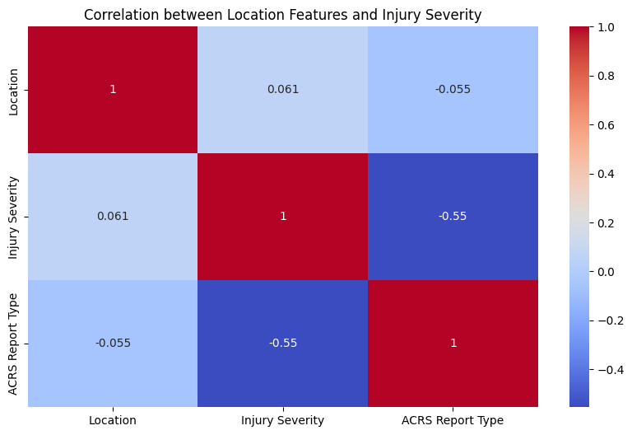
Correlation between Location, Injury Severity, and ACRS Report Type
Injury severity moderate negative correlation with ACRS report type, which means when variable Injury severity increases, variable ACRS report type decreases, and vice versa.

Slide 5
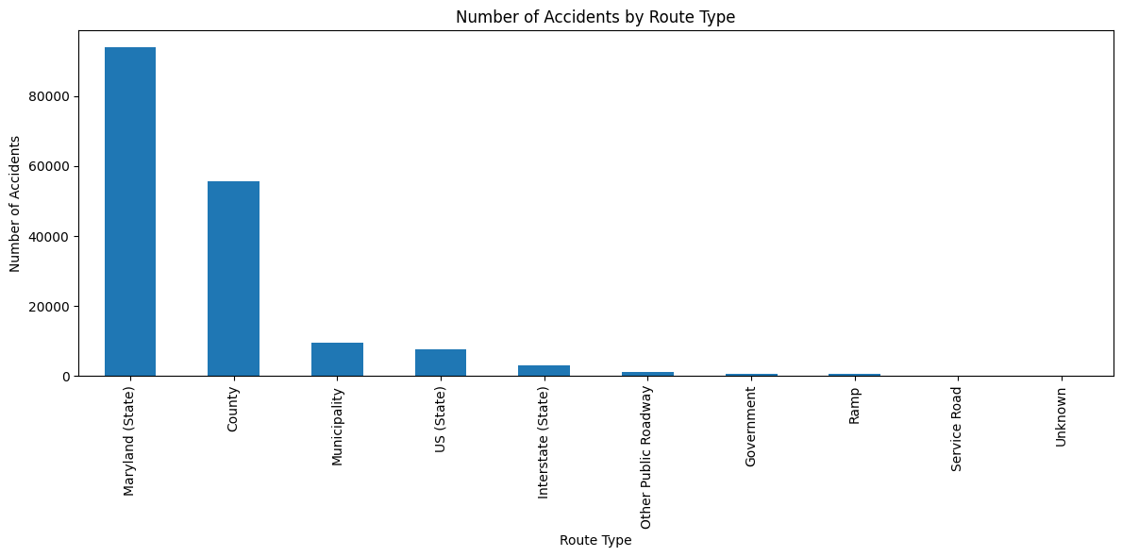
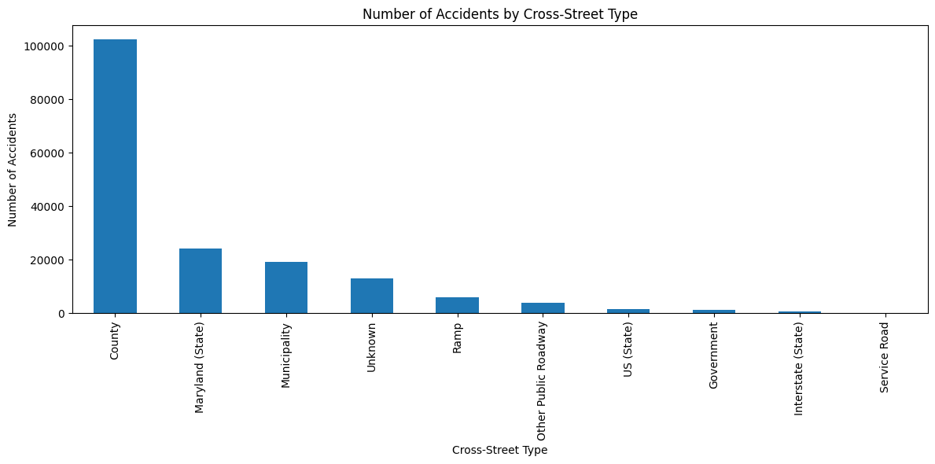
Number of Accidents by Route and Cross-Street Type
The most accident happens in Maryland (State) route type. Followed by County and Municipality.
County is a cross-street type where most accidents occur, followed by Maryland (state), and Municipality.

Slide 6
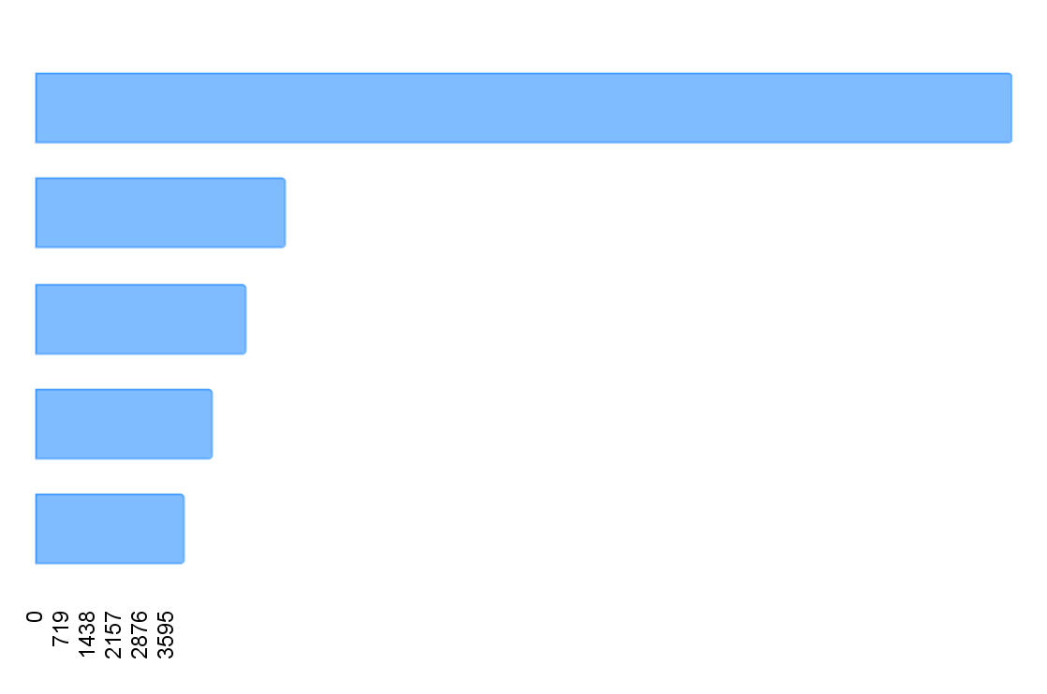
Number of Accident Based on Road Name
(Top 5)
26798 | Georgia Ave
6832 | New Hampshire Ave
5768 | Frederick Rd
4839 | Rockville Pike
4093 | Connecticut Ave

Slide 7
Number of Accident Based on Location
(Top 5)
Accident | Road Name | Location
12 | Columbia Pike | (39.045425, -76.99073667)
10 | Eisenhower Memorial Hwy | (39.0737933, -77.1647059)
9 | Veirs Mill Rd | (39.06099965, -77.09118779)
9 | Georgia Ave | (38.953, -77.338)
9 | Good Hope Rd | (39.10066667, -76.98297)

Slide 8
02
Temporal Analysis

Slide 9
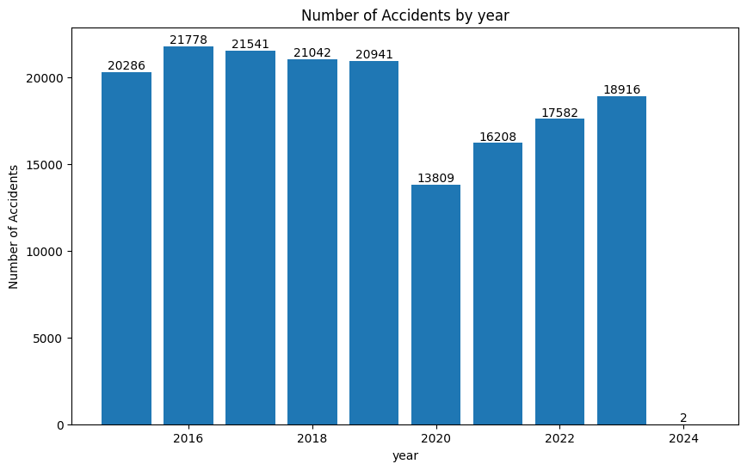
Number of Accidents during 2015-2024
The most accident occurs in 2016, 2017, and 2018.

Slide 10
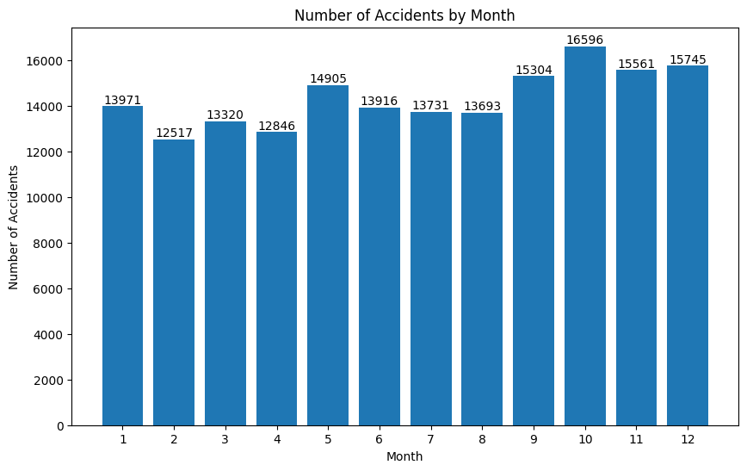
Number of Accidents by Month during 2015-2024
October, November, and December have the highest number of accidents.

Slide 11
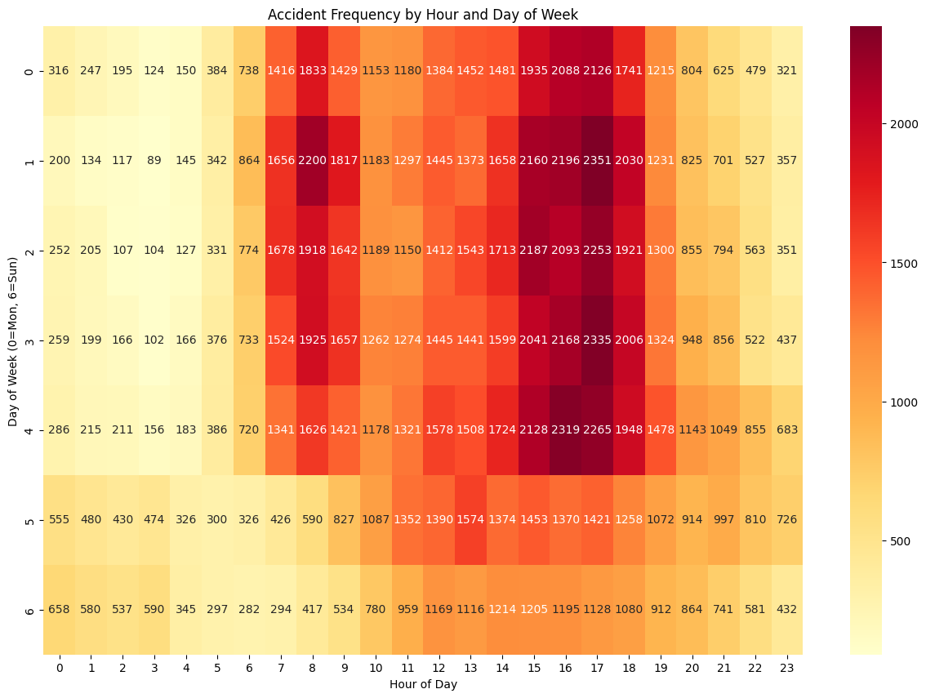
Accident frequency by hour and day of week
Mostly accidents happen in monday-friday,
around 7am-9am and 3pm-6pm.

Slide 12
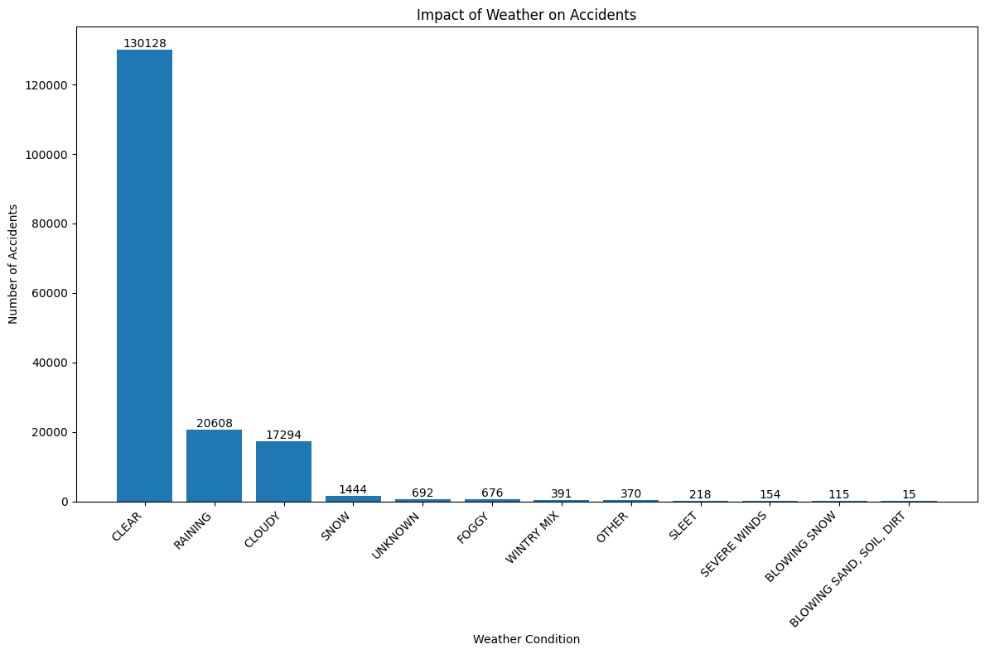
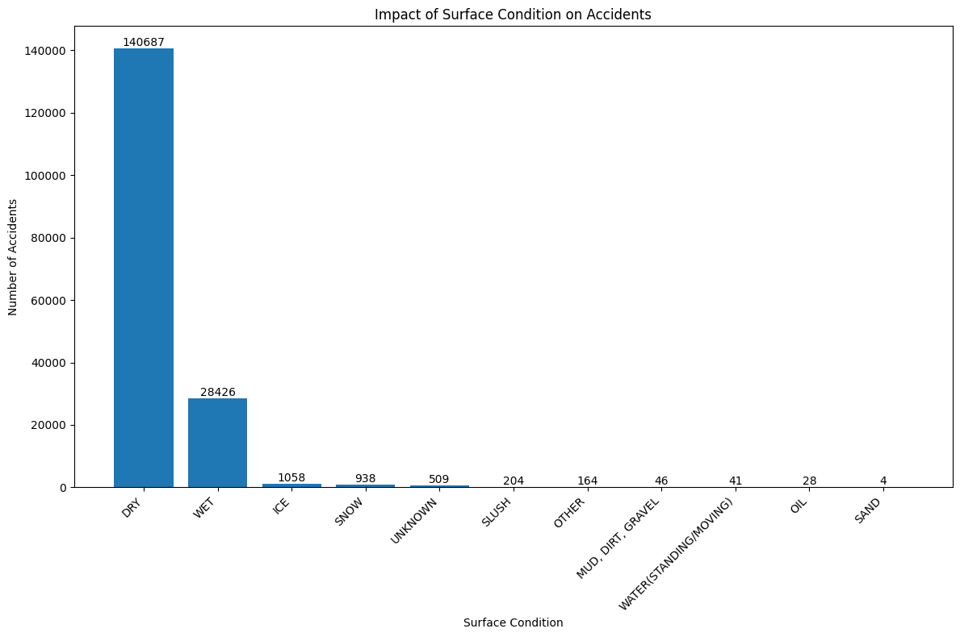
Number of Accidents Based on Weather and Surface Condition
The most accident happens when the weather is clear, followed by raining and cloudy.
Dry and wet have the highest number of accidents.

Slide 13
Road Conditions and Infrastructure
03

Slide 14
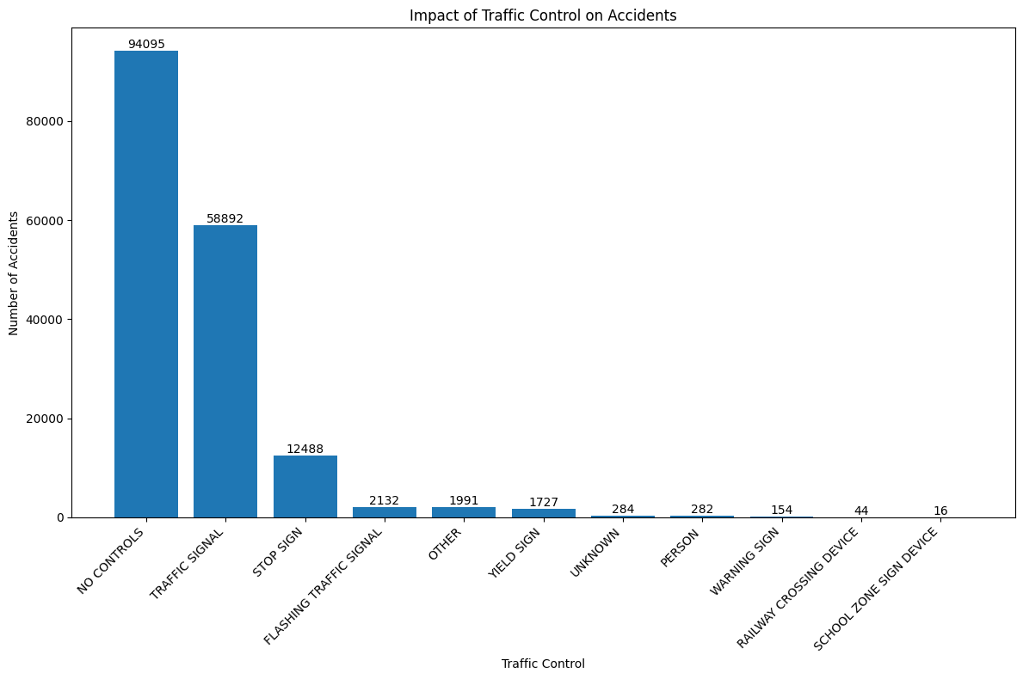
Impact of Traffic Control on accidents
Most accidents happen because of no controls, traffic signal, and stop sign.

Slide 15
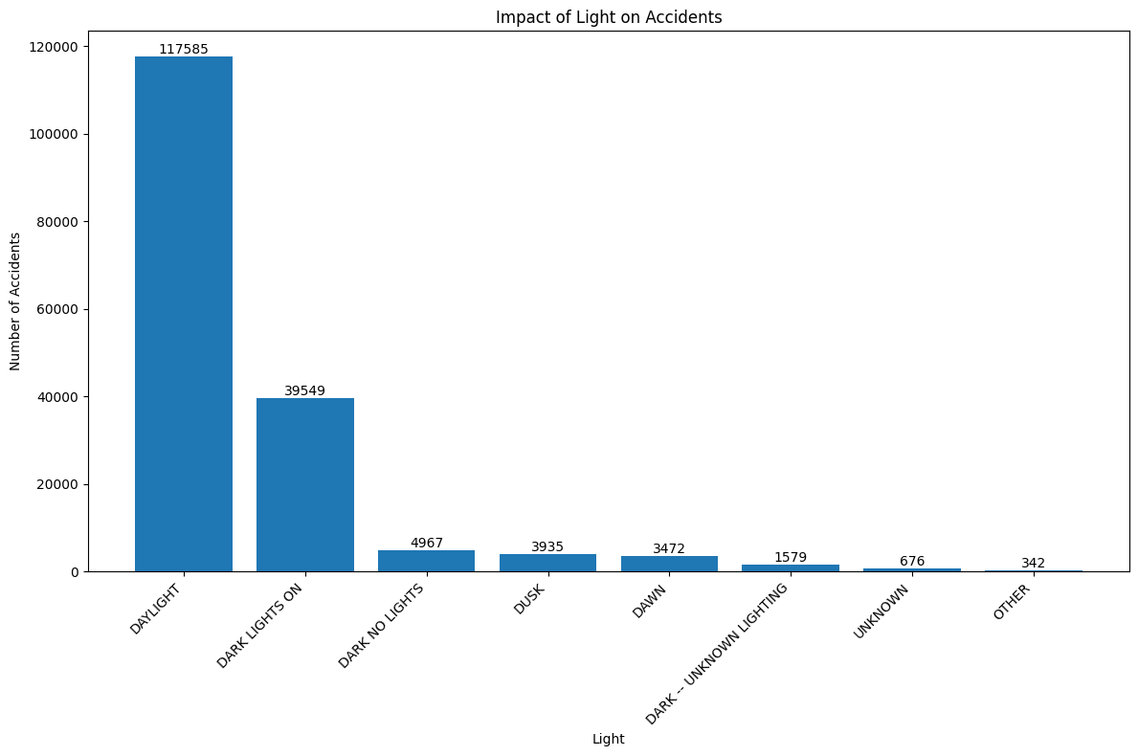
Impact of Lighting Condition on accidents
Most accidents happen when the daylight, dark with lights on, and dark without lights.

Slide 16
04
Accident Characteristics

Slide 17
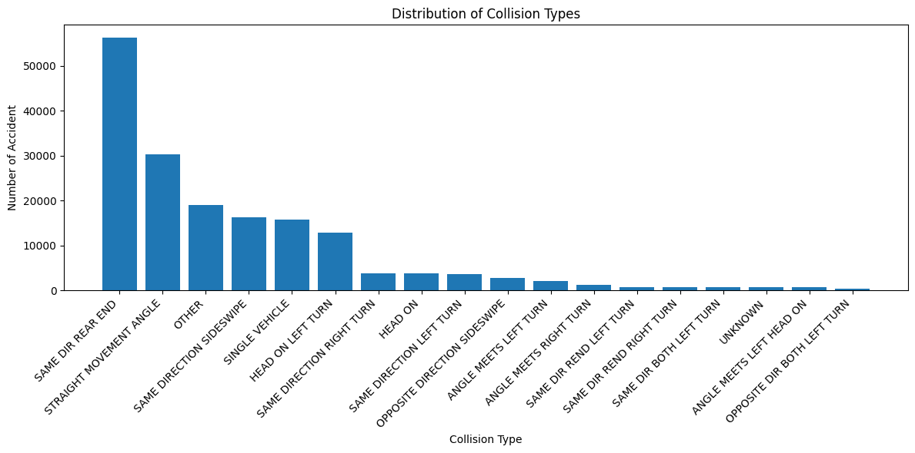
Collision Type Analysis
The most common types of collisions are same direction rear end collisions, straight movement angle, and other.

Slide 18
Number of Accident by ACRS Report Type
109452
62228
425
Property Damage Crash
Injury Crash
Fatal Crash

Slide 19
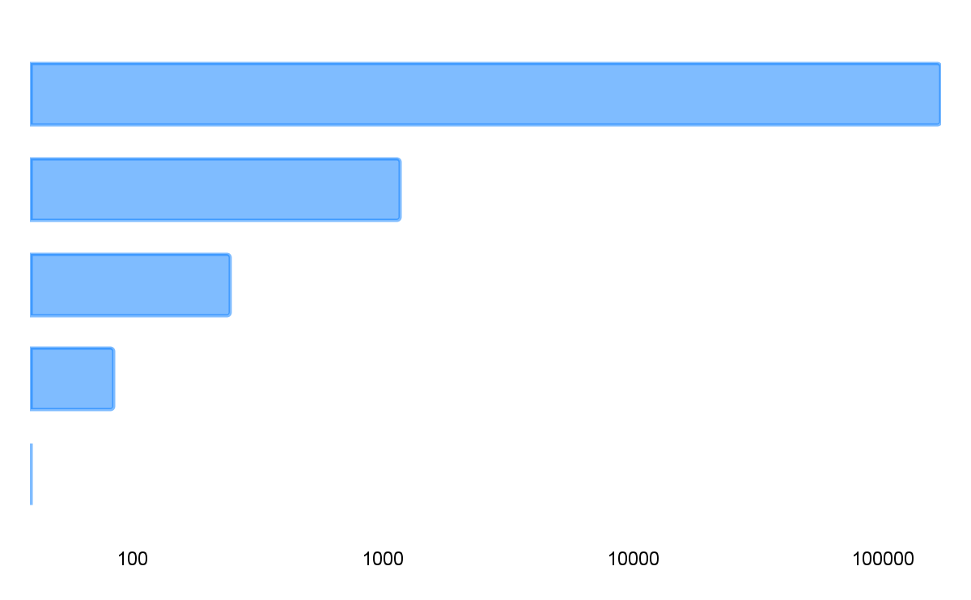
Number of Accident by Related Non-Motorist
Pedestrian | 170522
Bicyclist | 1169
Other | 246
Other Conveyance | 84
Machine Operator/Rider | 39

Slide 20
15
Number of Accidents by Off-Road Description
13
12
12
12
Parking Lot Of 11160 Veirs Mill Rd
Parking Lot Of 10901 Westlake Rd
Parking Lot Of 1283 Seven Locks Rd
Parking Lot Of 10323 Old Georgetown Rd
Parking Lot Of 11160 Veirs Mill Road

Slide 21
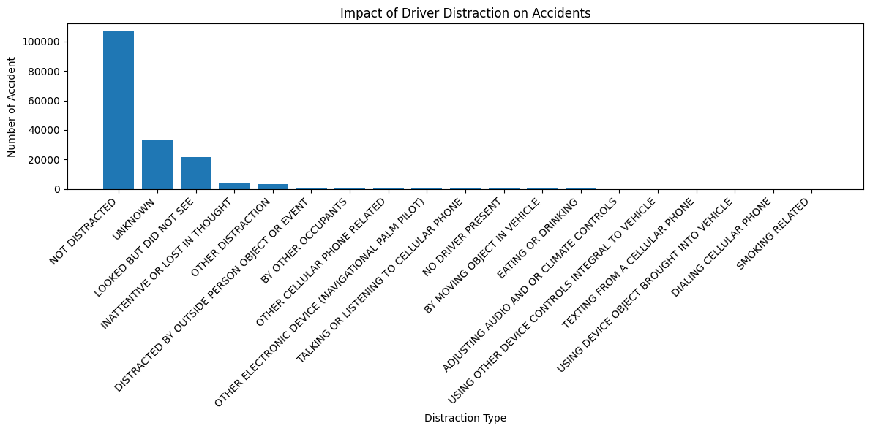
Impact of Driver Distraction on Accidents
Most accidents occur when the driver didn’t distract, unknown distraction, and when the driver looked but didn’t see.

Slide 22
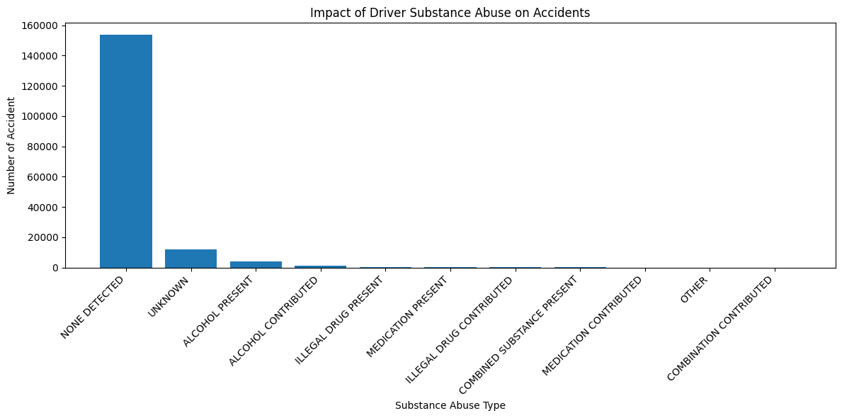
Impact of Driver Substance Abuse on Accidents
Most accidents occur when the driver has undetected substance abuse, followed by unknown substance abuse, and under the influence of alcohol.

Slide 23
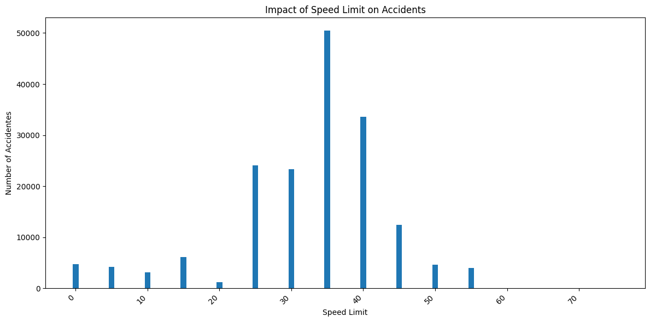
Impact of Speed Limit on Accidents
Most accidents happen when the speed limit is 35, 40, and 25.

Slide 24
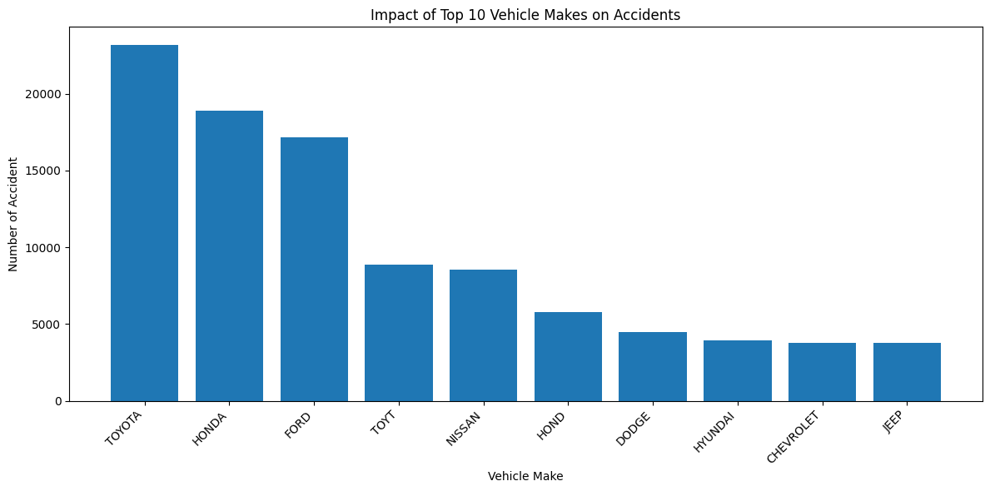
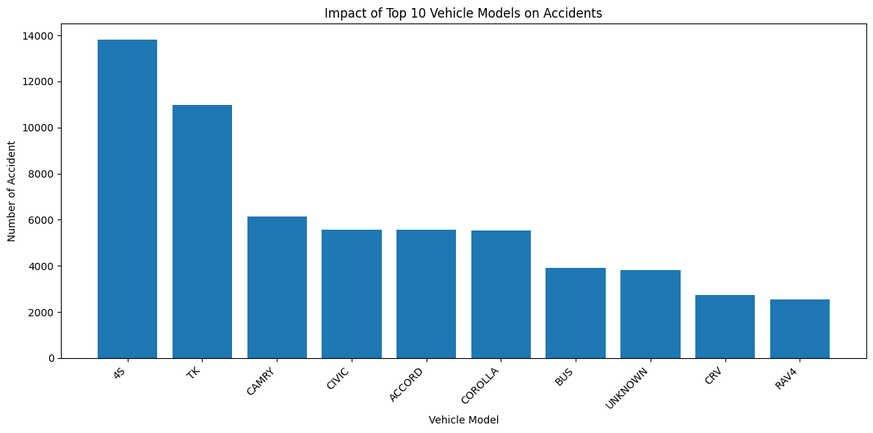
Impact of Vehicle Makes and Model on Accidents
The vehicle brands that are most frequently involved in accidents are Toyota, Honda, and Ford.
The vehicle models that are most frequently involved in accidents are 4S, TK, and Camry.

Slide 25
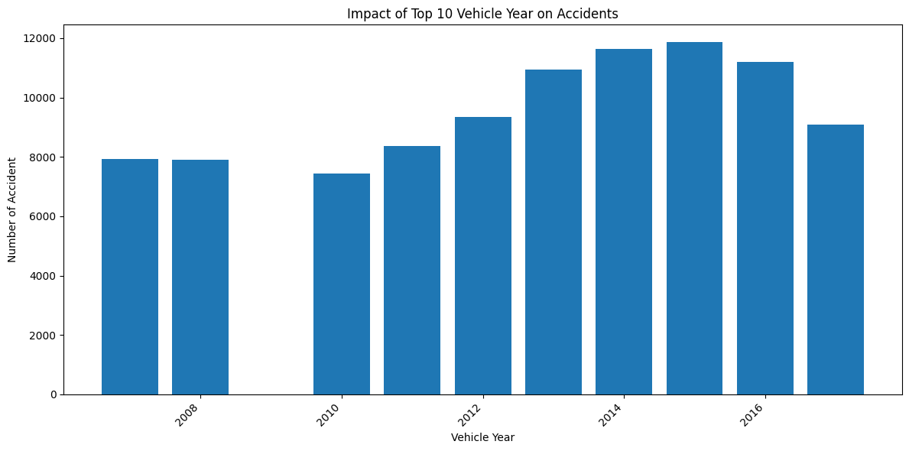
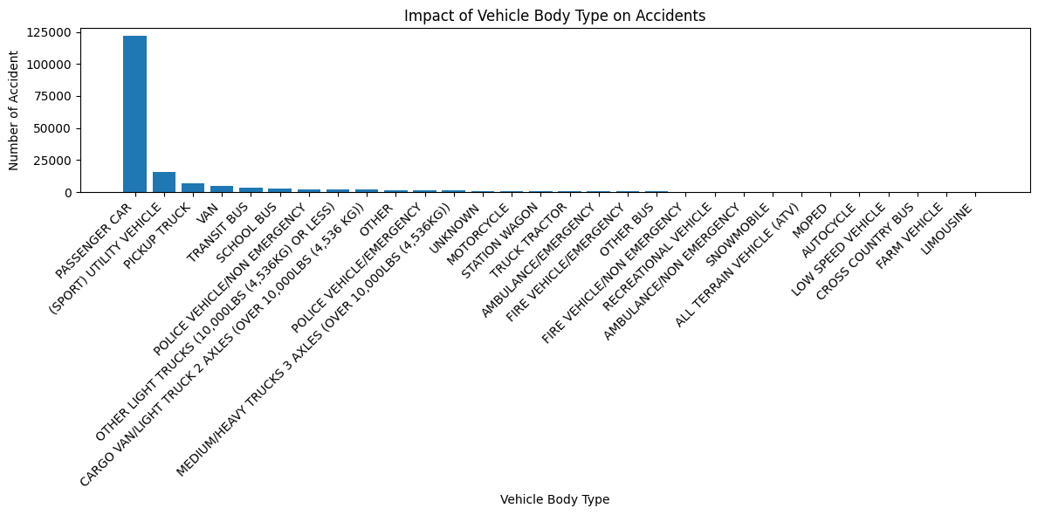
Impact Vehicle Year on Accidents
Impact of Vehicle Body Type on Accidents
The most common vehicle years for accidents are 2014, 2015, and 2016.
The vehicle body that are most frequently involved in accidents are passenger truck, (sport) utility vehicle, and pickup truck.

Slide 26
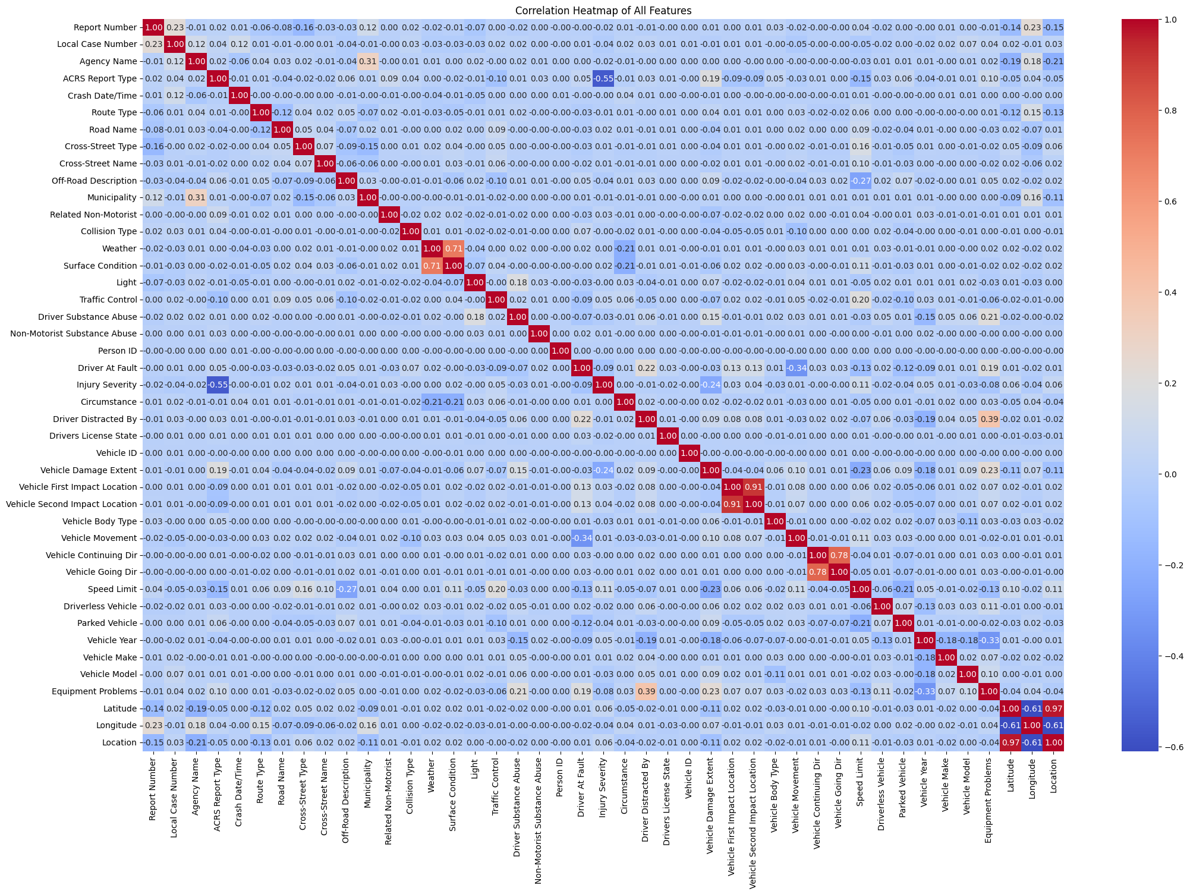
Correlation of All Features in Crash Data
Positive correlation
High correlation between:
Vehicle's first impact location and Vehicle’s second impact location
Vehicle continuing direction and Vehicle going direction
Weather and Surface Condition
Weak correlation between:
Driver distracted by and Equipment problems
Negative correlation:
Moderate correlation between:
ACSR report type and Injury severity
Weak correlation between:
Driver at fault and Vehicle movement
Vehicle year and Equipment problems

Slide 27
Thanks!
Do you have any questions?
anasya31.aa@gmail.com

